Slide 1
Branching

Slide 2
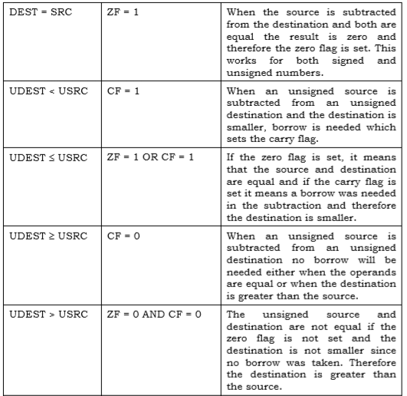
How to interpret the flags (1)?

Slide 3
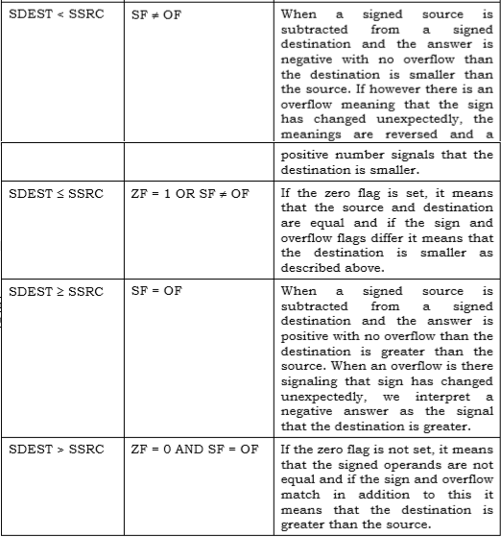
How to interpret the flags (2)?

Slide 4
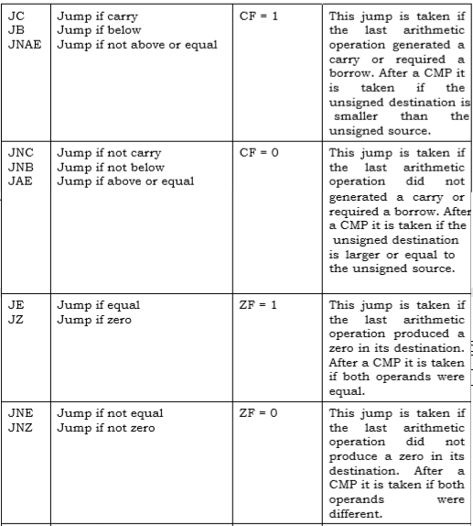
Conditional Jumps (1)

Slide 5
Conditional Jumps (2)

Slide 6
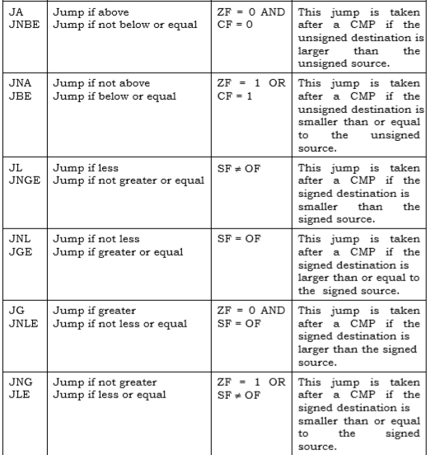
Conditional Jumps (3)

Slide 7
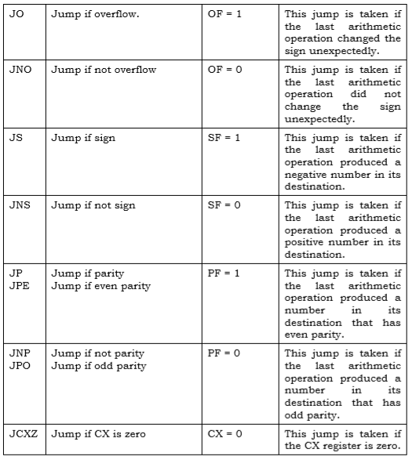
Conditional Jumps (4)

Slide 8
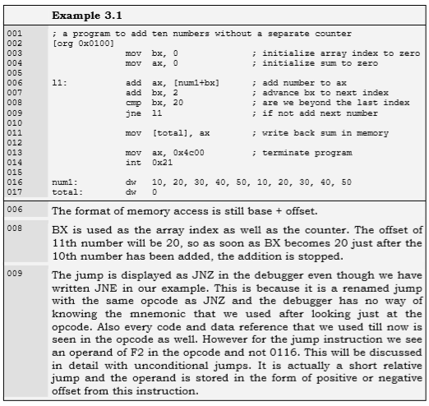
Example 3.1.

Slide 9
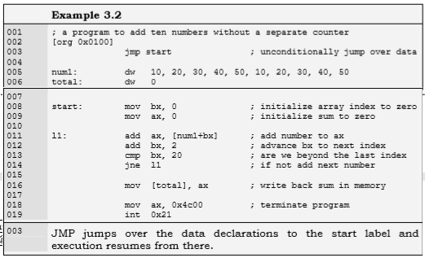
Example 3.2.: Unconditional Jump

Slide 10
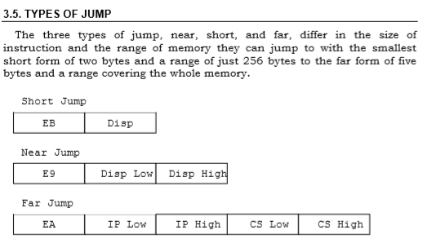
Types of JUMP (1)

Slide 11
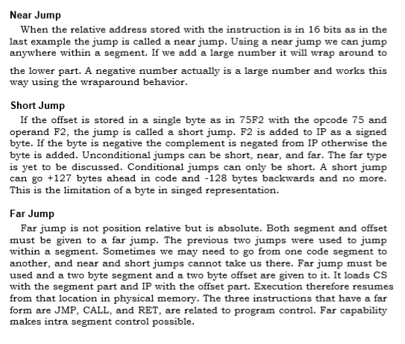

Slide 12
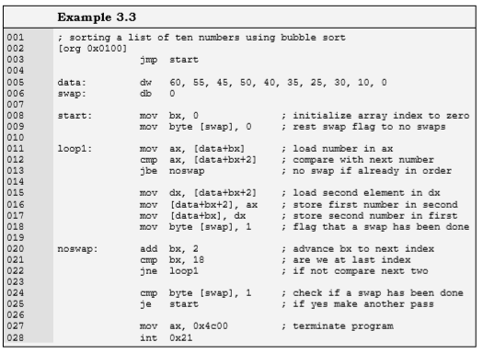
Sorting Example

Slide 13
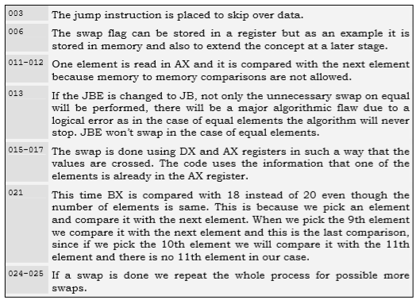

Slide 14
